Slide 1
dbms
Module 1 part 1

Slide 2
index
DBMS
Characteristics of DB system
DB users
structured, semi-structured and unstructured data
Data models
Schema
Three schema architecture

Slide 3
DBMS
A database-management system (DBMS) is a collection of interrelated data and a set of programs to access those data
The collection of data, usually referred to as the database, contains information relevant to an enterprise.
The primary goal of a DBMS is to provide a way to store and retrieve database information that is both convenient and efficient

Slide 4
Characteristics of Database system
DBMS Vs FILE SYSTEM
1.Data redundancy and inconsistency
2.Difficulty in accessing data
3.Data isolation
4.Integrity problems
5.Atomicity problems
6.Security problems

Slide 5
Database Users
Sophisticated users: They Interact with the system without writing programs
Naive users: They are unsophisticated users who interact with the system by invoking one of the application programs that have been written previously
Application programmers: They are computer professionals who write application programs
Specialized users: They are sophisticated users who write specialized database applications that do not fit into the traditional data-processing framework.

Slide 6
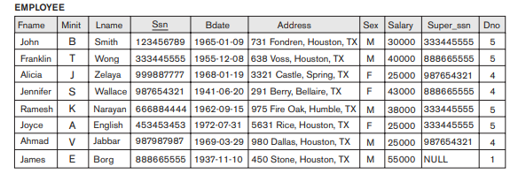
structured, semi-structured and unstructured data
Structured data: The information stored in relational databases is known as structured data because it is represented in a strict format.

Slide 7
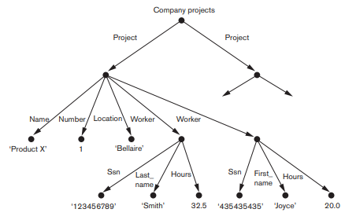
2. Semistructured data: It is information that does not reside in a relational database but that has some organizational properties that make it easier to analyze.

Slide 8
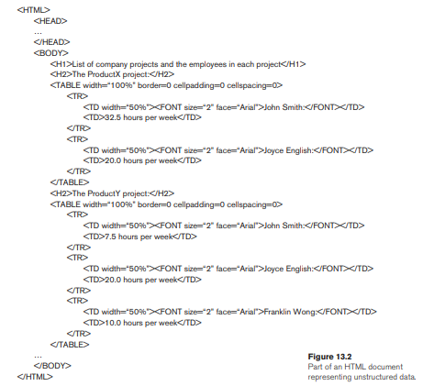
3. Unstructured data: It is a data which is not organized in a predefined manner

Slide 9
Data Models
A collection of conceptual diagrams that can be used to describe the structure of a database
Categories of Data Models
High-level or conceptual data model provide concepts that are close to the way many users perceive data
Eg:entity–relationship model
Low-level or physical data models provide concepts that describe the details of how data is stored on the computer storage media
Representational or implementation data models which provide concepts that may be easily understood by end users but that are not too far removed from the way data is organized in computer storage
Eg:network and hierarchical models

Slide 10
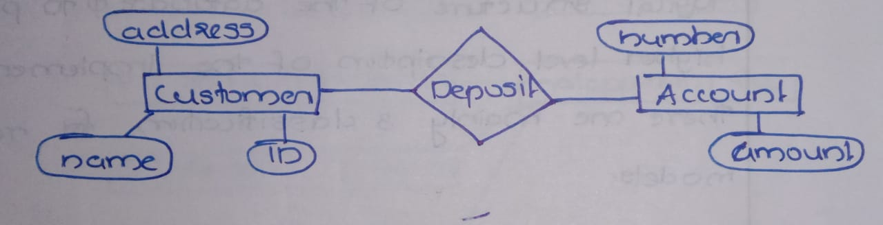
entity–relationship model
A popular high-level conceptual data model.
Conceptual data models use concepts such as entities, attributes, and relationships.
Entity: An entity represents a real-world object
Relationship: Relationship among those objects
Attributes: Set of properties for describing the entities

Slide 11
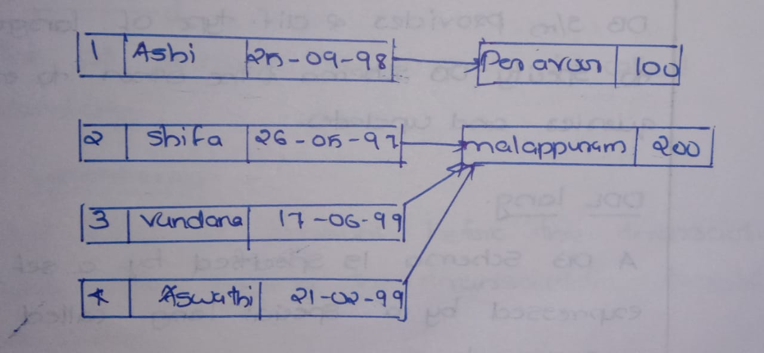
Network model
It is representational model
Data in the network model are represented by collection of records and the relationship among the data are represented by link

Slide 12
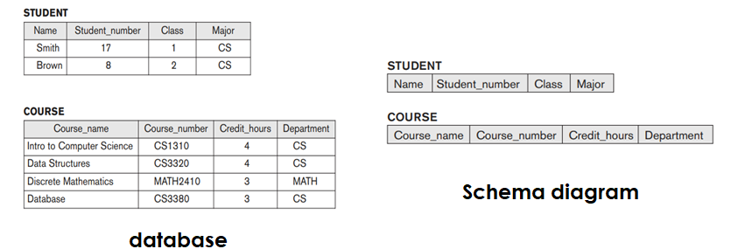
schema
The overall design of database system is called the database schema
Layout or blueprint of a database
The diagramatic representation of schema is called schema diagram

Slide 13
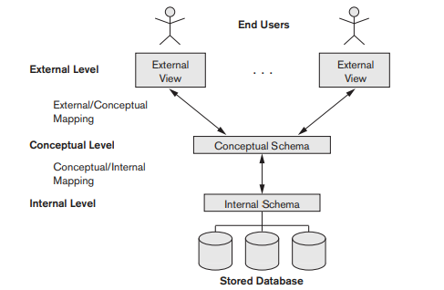
Three Schema architecture
Goal: To separate the user application and the physical database
Schema can be defined in 3 levels:
1.Internal level
2.Coceptual level
3.External level

Slide 14

1.Internal level
Describe the physical structure of the database
2.Conceptual level
Hide the details of the physical storage structure and concentrates on describing entities, data types, relationships etc.
3.External level
Describes the part of the database that a user is interested in and hides the rest of the database from the user group

Slide 15
THANK YOU

Slide 16
dbms
Module 1 part 2

Slide 17
index
Database Languages
Database architectures
ER model
Entity set ,attributes and relationships
Weak entities
Constraints

Slide 18
Database languages
DDL(Data Definition Language): used to specify the conceptual schema only
SDL(Storage Definition Language ):used to specify the internal schema
VDL(View Definition Language): to specify user views and their mapping to the conceptual schema

Slide 19
4. DML(Data Manipulation Language): for manipulation of data in the database
Types of DML:
1.High-level(or non-procedural DML):specify what data are needed without specifying how to get those data.
2.Low-level(or procedural DML): specify what data are needed and how to get those data

Slide 20
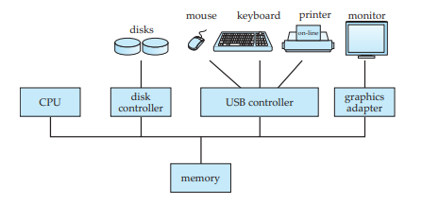
Database architectures
Centralized architecture
They run on a single computer system and do not interact with other

Slide 21
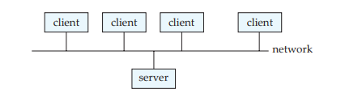
2. Client–Server Systems
Client: User machine that provides user interface capabilities and local processing
Server: Provides services to client machines

Slide 22
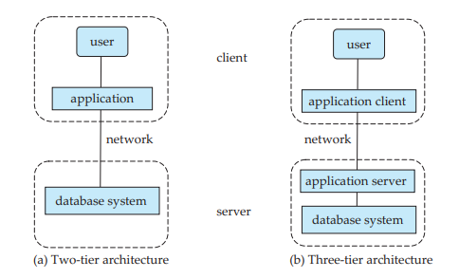

Slide 23

ER model
A popular high-level conceptual data model.
Conceptual data models use concepts such as entities, attributes, and relationships.
Entity: An entity represents a real-world object
Relationship: Relationship among those objects
Attributes: Set of properties for describing the entities

Slide 24
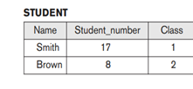
ENTITY
An entity represents a real-world object
It can be person,place,job etc
A collection of entities that have the same attributes is called entity type. Eg: STUDENT
Collection of entities of a particular entity type at a point in time is called entity set

Slide 25
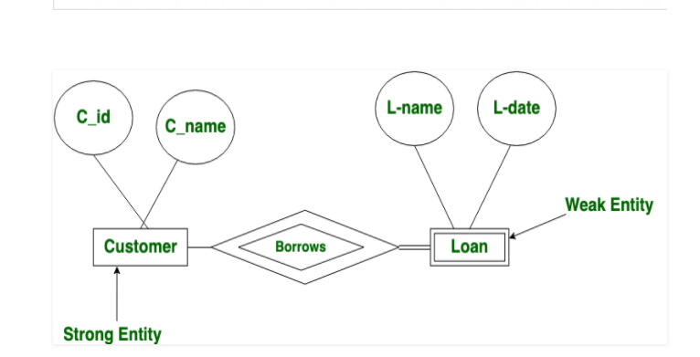
Weak entity
The entity sets which do not have sufficient attributes to form a primary key are known as weak entity sets

Slide 26
DIFFERENT TYPES OF ATTRIBUTES
1.Simple and composite attributes
Composite attribute can be divided into further parts(Eg:Name) and simple attribute cannot be divided into further(Eg:Age)
2.Single-valued and multi-valued attribute
Single-valued attribute have a single value for a particular entity(Eg:Age) and multi-valued attribute can have set of values for a particular entity(Eg: Languages known)
3.Derived and stored attributes
Derived attribute can be derived from other attributes(Eg:Age) and stored attributes are attributes from which the values of other attributes are derived (Eg:Birth date)

Slide 27
RELATIONSHIP
It is the association among 2 or more entities
Eg: teacher teaches student
The number of entity types that participate in a relationship is called degree of relationship
1. Unary relationship:Exist when there is an association with only one entity
2.Binary relationship: two entities
3.Ternary relationship: three entities

Slide 28
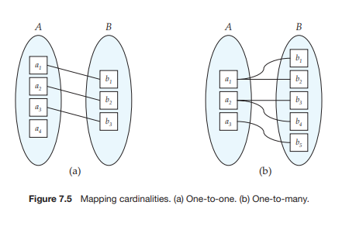
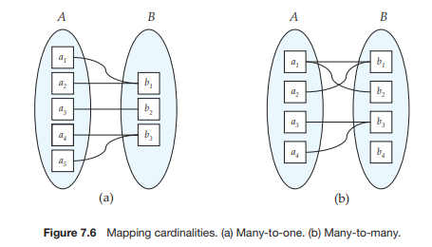
constraints
Mapping Cardinalities or cardinality ratios
Maximum number of relationship instances that an entity can participate in.

Slide 29
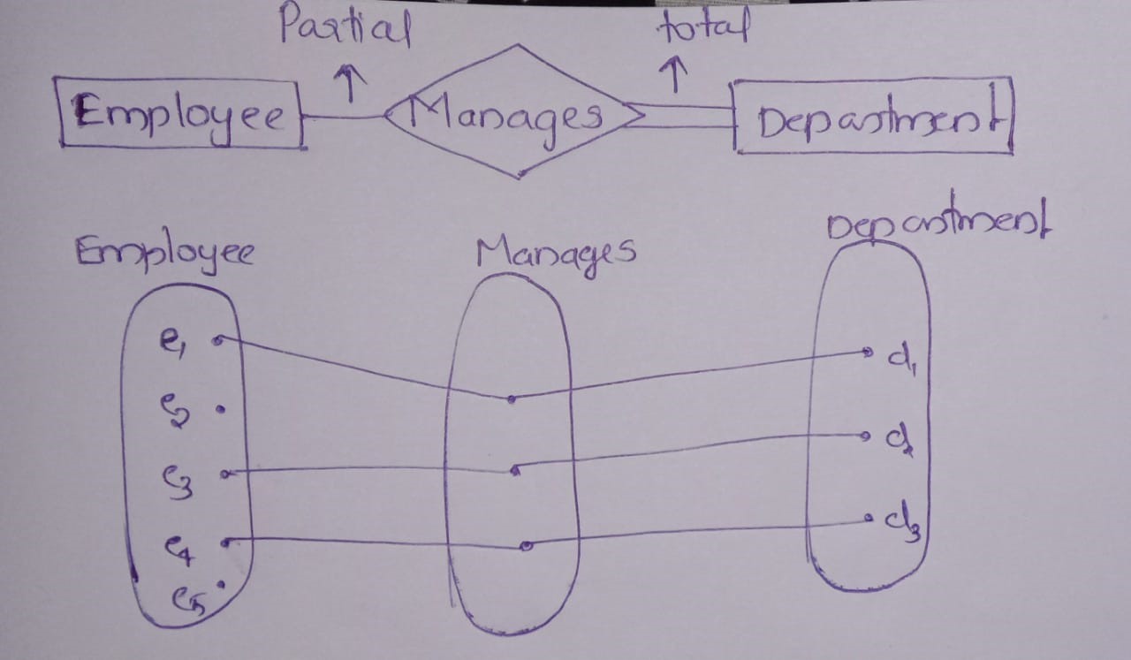
2.Participation Constraints
Specifies whether existence of an entity depends on its being related to another entity
2 types: Total participation & Partial participation

Slide 30
THANK YOU

